Slide 1
Detecting COR_PROFILER Manipulation for Persistence
By Jose & Tyler

Slide 2
Agenda
Introduction
Mockingbird
Description of the exercise
Assumptions
Basic Concepts
Environment variables
.NET framework
What are PROFILERs and Why do you use it in your Network Environment
Abusing COR_PROFILER
How it can be abused
How I abused it
Testing Environment
Infrastructure setup
Payload setup
Testing

Slide 3

Introduction

Slide 4
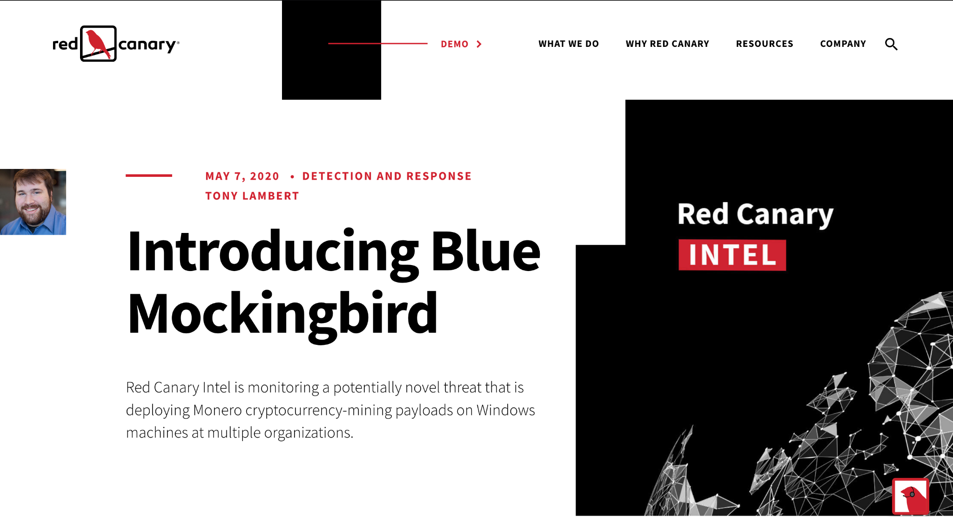

Slide 5
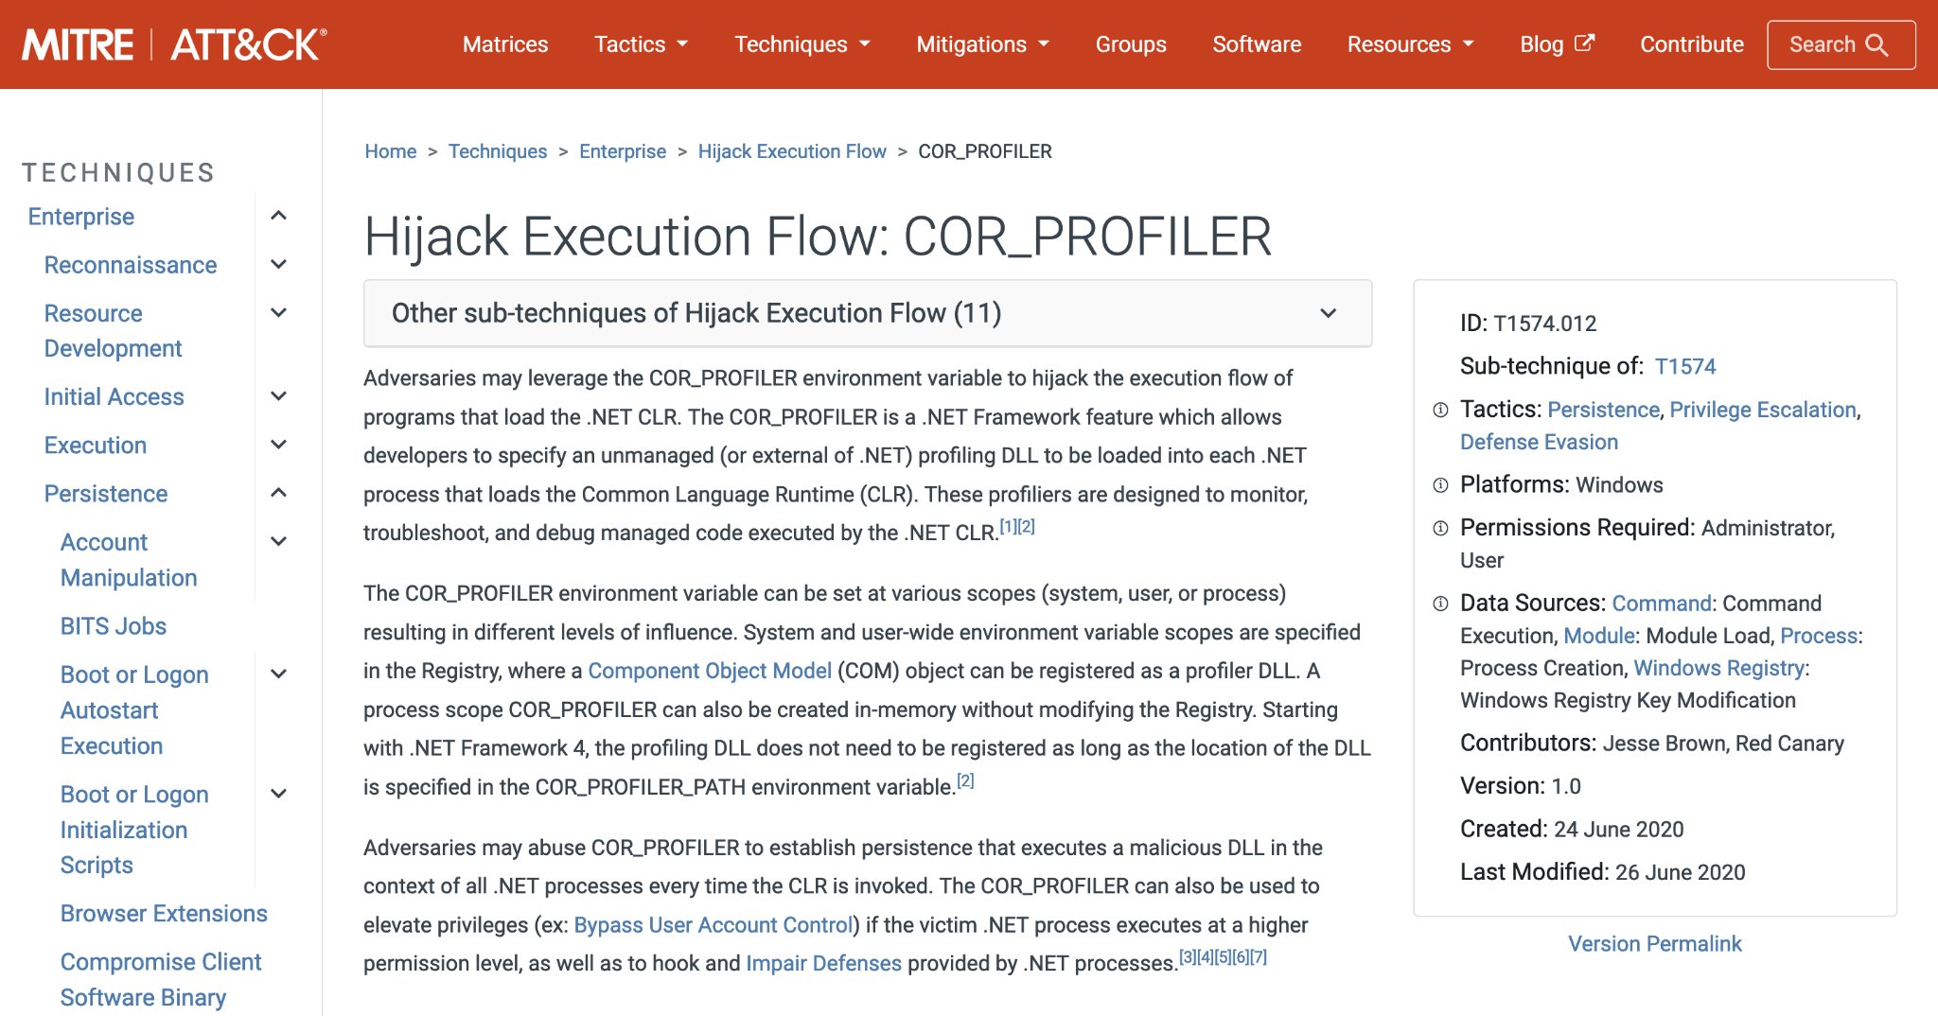

Slide 6

Basic Concepts

Slide 7
What are Environment Variables?
Environment Variables are dynamic, named values that the OS and applications can use to affect their behavior. Usually set in the registry on Windows.
Typical Environment Scopes and Where they come from:
System: HKLM\SYSTEM\CurrentControlSet\Control\Session Manager\Environment
User: HKCU\Environment and/or HKU\SomeSID\Environment
Process: Inherits environment from the parent process, and can be set manually
Others:
Service:
Environment REG_MULTI_SZ value in HKLM\SYSTEM\CurrentControlSet\Services\SomeServiceName
AppEnvironment REG_MULTI_SZ value in HKLM\SYSTEM\CurrentControlSet\Services\SomeServiceName\Parameters
A other places in the registry?

Slide 8
What is the .NET Framework?
The .NET Framework is a software development platform developed by Microsoft for building applications on Windows.
.NET Framework runtime needs to be installed to run .NET apps
The runtime version need to be the same as the app version
A .NET Framework runtime is usually installed by default on Windows
Different Windows versions come with different .NET runtimes
There’s also .NET Core, which is cross platform

Slide 9
What is a Profiler?
“A profiler is a tool that monitors the execution of another application. A common language runtime (CLR) profiler is a dynamic link library (DLL) that consists of functions that receive messages from, and send messages to, the CLR by using the profiling API. The profiler DLL is loaded by the CLR at run time.”
https://docs.microsoft.com/en-us/dotnet/framework/unmanaged-api/profiling/profiling-overview

Slide 10

Abusing COR_PROFILER manipulation

Slide 11
Things you can do with COR_PROFILER
Persistence (We played with this)
https://dmcxblue.gitbook.io/red-team-notes-2-0/red-team-techniques/persistence
https://github.com/redcanaryco/atomic-red-team/blob/master/atomics/T1574.012/T1574.012.md
Bypass UAC
https://www.digitalcitizen.life/uac-why-you-should-never-turn-it-off/
https://offsec.almond.consulting/UAC-bypass-dotnet.html
Bypass App Whitelisting
https://digitalguardian.com/blog/what-application-whitelisting-application-whitelisting-definition
https://0xdf.gitlab.io/2019/03/15/htb-ethereal-cor.html

Slide 12
Testing Environment

Slide 13
Testing Environment
1st test
Used Azure-Sentinel2Go for everything
1 Windows VM for victim
1 Ubuntu VM with metasploit for red team
Both VMs in Azure, in the same VNet
This worked but it was kind of unrealistic, and boring
Subsequent tests (so far)
Used Azure-Sentinel2Go for the victim
1 Windows VM for victim in Azure
Custom red team infrastructure separate from Victim VM network
More realistic and more fun

Slide 14
Red Team Infrastructure Setup

Slide 15
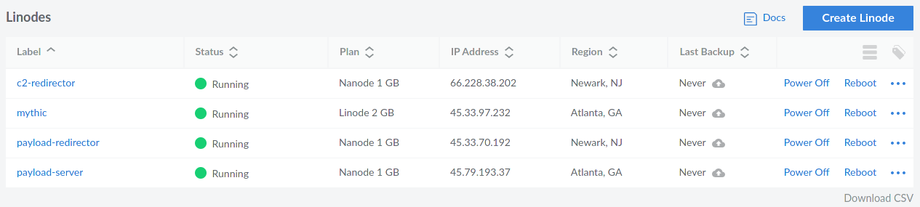
Servers
2 for redirectors
1 for hosting payloads
1 for C2

Slide 16
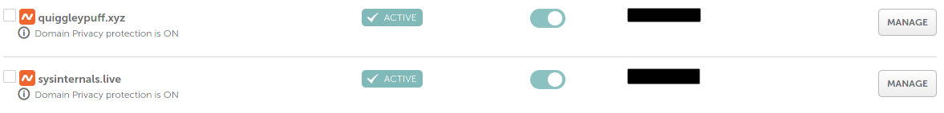
Domain Names
1 for the C2 redirector
1 for the payload redirector

Slide 17
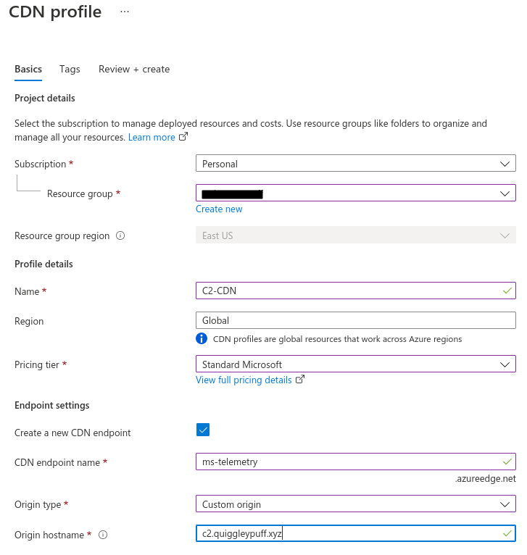
CDN
1 for C2 domain
I didn’t try domain fronting through a different domain, but this could be used for that.
https://bigb0ss.medium.com/redteam-c2-redirector-domain-fronting-setup-azure-adbedbd28305

Slide 18
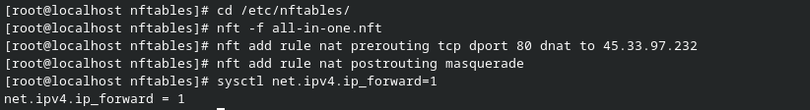
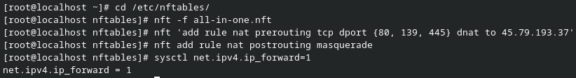
Rediretors with nftables
https://github.com/bluscreenofjeff/Red-Team-Infrastructure-Wiki#iptables-for-http
https://wiki.nftables.org/wiki-nftables/index.php/Performing_Network_Address_Translation_(NAT)

Slide 19
Payload Server / Pretending to be sysinternals
The payload server domain name was sysinternals.live, which is close to the legitimate live.sysinternals.com
The real sysinternals site has an website and SMB shares for people to download sysinternals. I can copy all the files from the real sysinternals to the evil sysinternals, and will look the same (pretty much)
We can serve our payloads alongside the sysinternals stuff to look more legitimate. We could also serve fake versions of the sysinternals tools too.
There are nicer ways to do this, like with apache rewrite rules and stuff, but I’m busy and this works so shut up

Slide 20
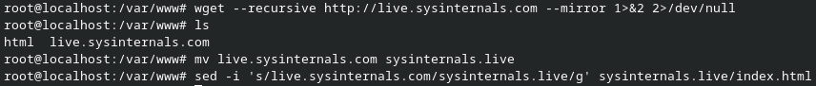
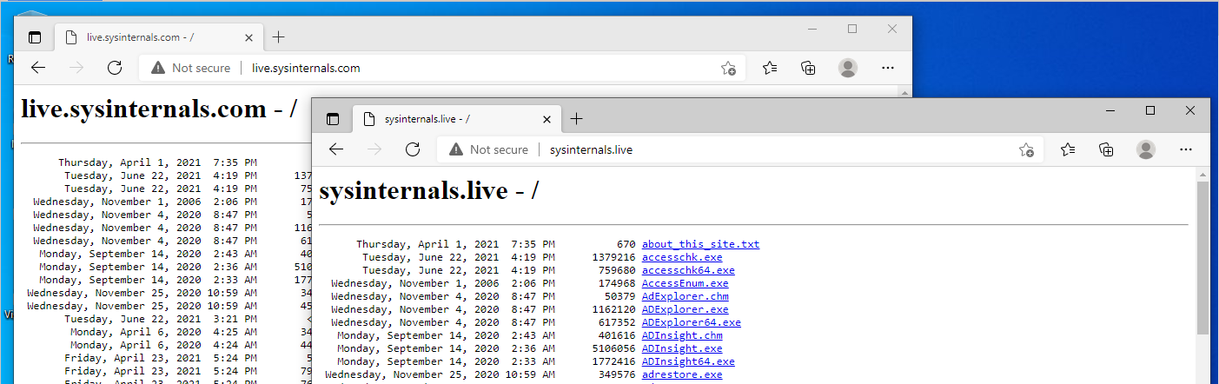
Payload Server / mimicking website
Copy the real sysinternals site, change the index.html to say sysinternals.live, and serve with apache

Slide 21
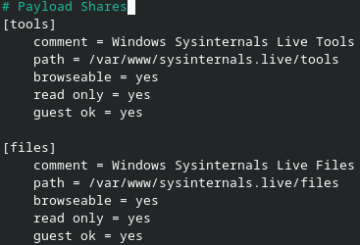
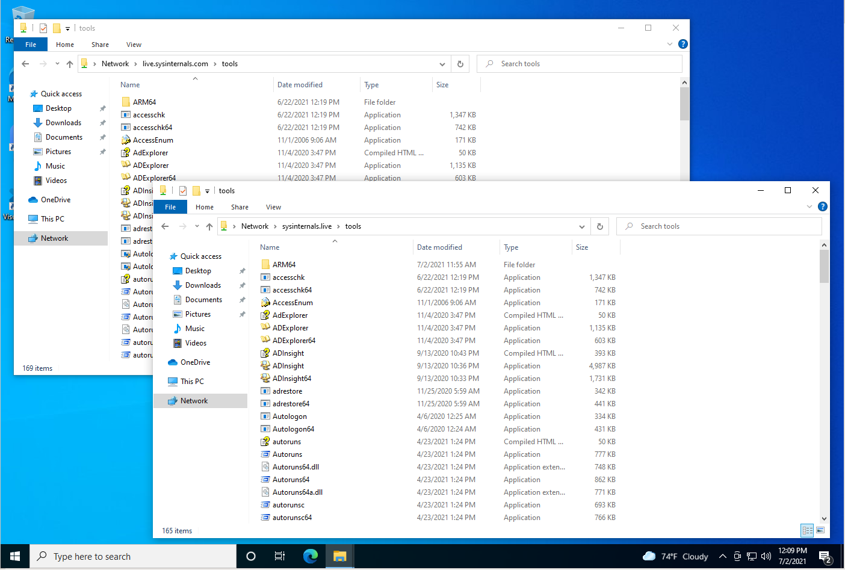
Payload Server / mimicking SMB shares
Install samba and setup some shares

Slide 22
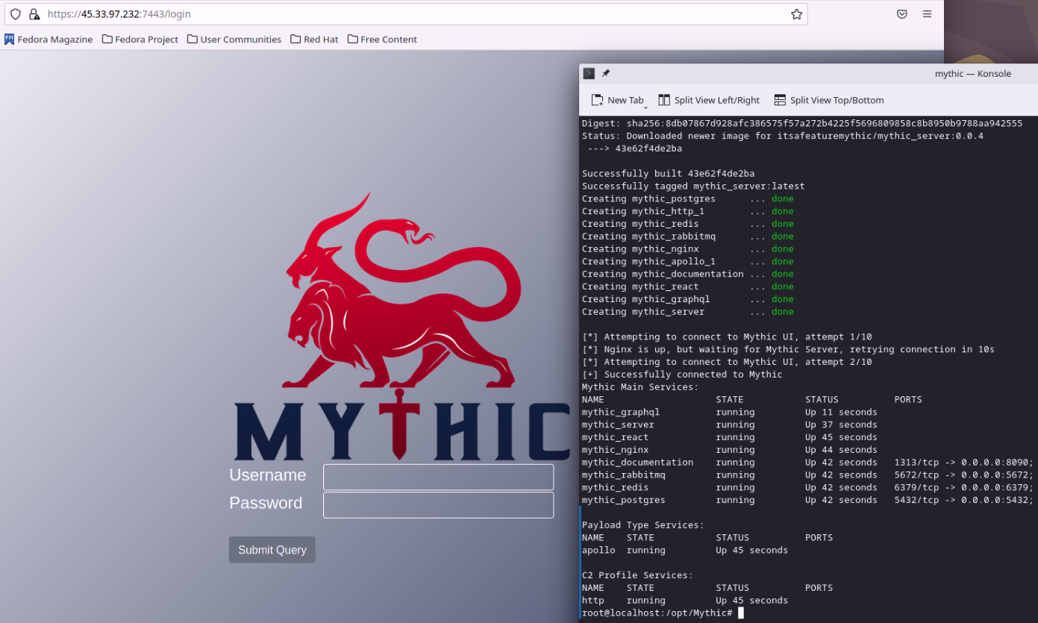
Mythic
https://docs.mythic-c2.net/installation
I only used the HTTP C2 profile (https://github.com/MythicC2Profiles/http) and the Apollo agent (https://github.com/MythicAgents/Apollo)

Slide 23
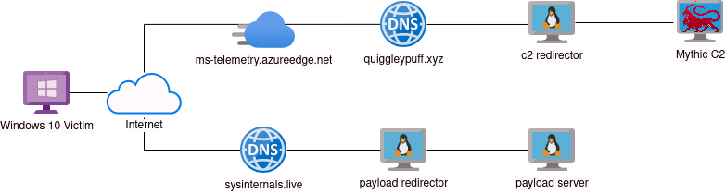
Final Product

Slide 24
EvilProfiler payload

Slide 25
What does EvilProfiler do?
https://github.com/quiggleypuff/EvilProfiler
Load shellcode resource that was compiled into the payload
The shellcode should be xor’d to beat signature detection
Copy the xor’d shellcode resource to an executable buffer
Xor the shellcode with a predefined key, so it will run when called
Write the executable buffer into the memory of the calling process (the one the loaded the EvilProfiler)
Create a remote thread on the calling process, which executes the shellcode in that process

Slide 26
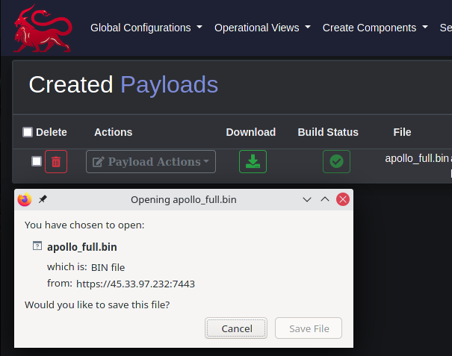
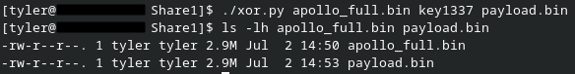
Creating a payload with Apollo shellcode
Create an Apollo payload in shellcode format and download it
Xor shellcode for use with EvilProfiler
My EvilProfiler payload wants the shellcode to be xor’d, and Mythic/Apollo can’t xor the out for you like msfvenom can. So I made a simple python script to do it.

Slide 27
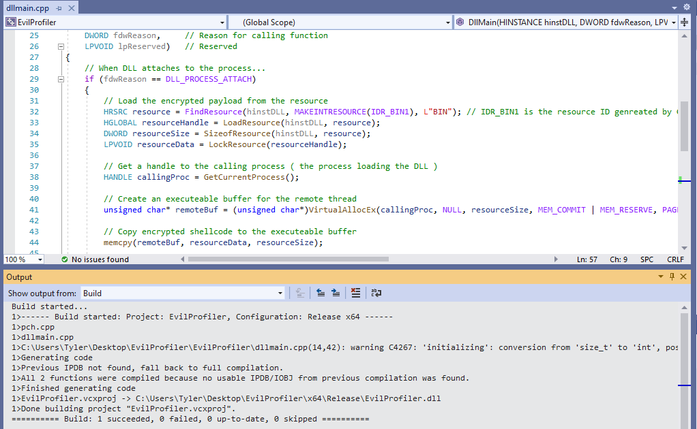
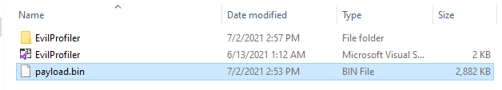
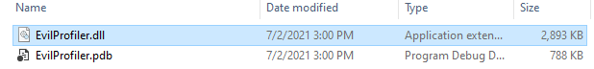
Create EvilProfiler.dll
Add payload.bin to project folder and build

Slide 28
Tests

Slide 29
Test #1 - User Environment
Ran a powershell script that did the following
Download payload to victim machine, to some user writable directory
Set HKCU\Software\Classes\CLSID\SomeGUIDValue\InprocServer32 to payload path
Set COR_ENABLE_PROFILING=1, COR_PROFILER=ThatGUIDValue,and COR_PROFILER_PATH=C:\Path\To\Payload
When current user’s processes restart, or this user logs out and logs in, environment variables are active.
All .NET apps run by that user will load the payload when they execute, spawn a new process, and inject a meterpreter into that process

Slide 30
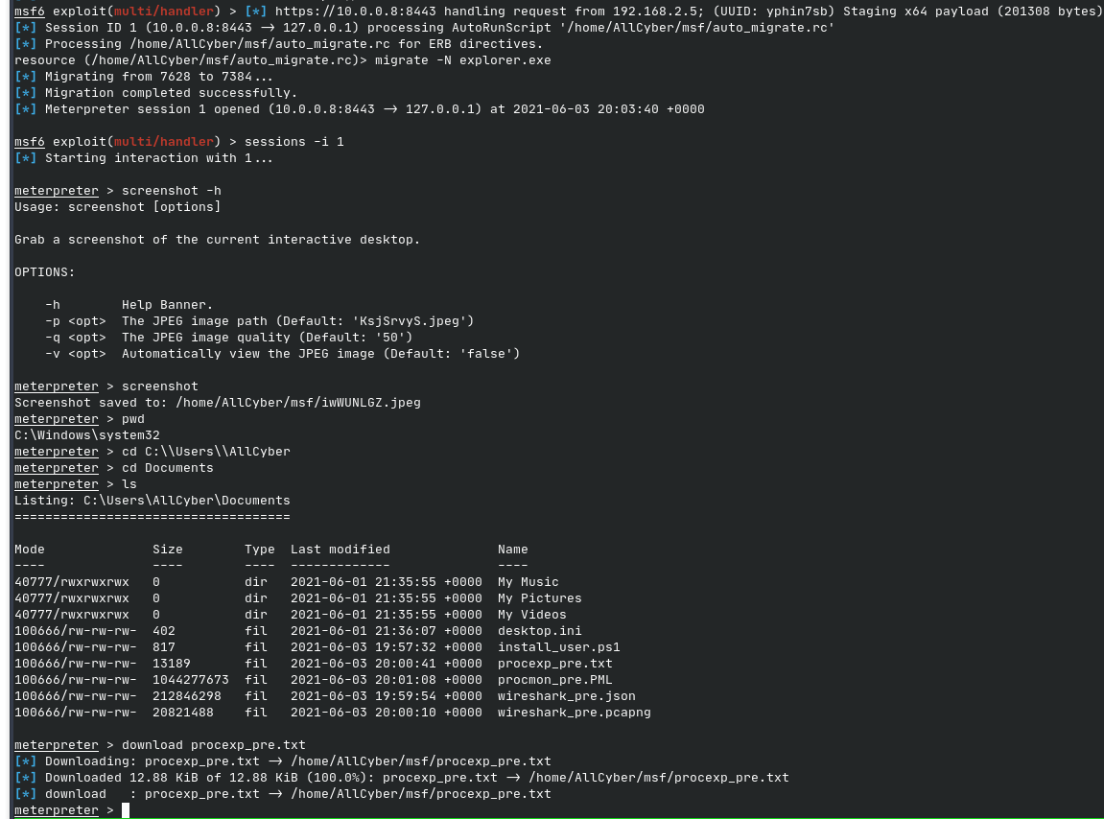
Test #1 - Postexploitation

Slide 31
Test #1 - Random Thoughts
Can get tons of callbacks from the same user, which is noisier than it needs to be 👎
At this point, the payload created a new process and attached a thread to it. That creates tons of extra processes. Which is also noisy. 👎
Used an autorun script to use migrate to explorer.exe and kill the spawned process with new sessions. I should’ve used priv_migrate, so I don’t downgrade high integrity processes. 👎

Slide 32
Test #2 - System Environment
Ran a batch script as an administrator that did the following:
Copy payload over SMB from payload server to C:\Windows\system32
Set COR_ENABLE_PROFILING=1, COR_PROFILER=SomeGUIDValue,and COR_PROFILER_PATH=C:\Path\To\Payload in system environment
When apps restart, or the system reboots, the environment variables will be active.
ALL .NET apps that run will load the payload when they execute, and inject an Apollo agent into their process

Slide 33
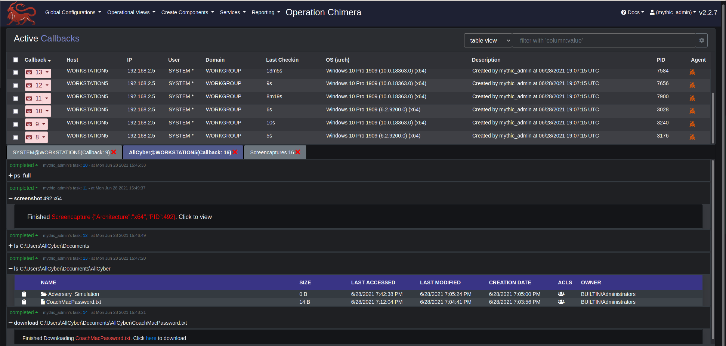
Test #2 - Postexploitation

Slide 34
Test #2 - Random Thoughts
The payload doesn’t spawn a new process anymore 👍
Some processes don’t live long enough to be very useful 👎
Still gets tons of callbacks from the same host. Potentially more than last time 👎
Can get callbacks from all users and the system, including NT Authority\ System 👍
.NET payloads/tools were annoying. They trigger original payload on themselves 👎
Could use Impacket’s SMB server to capture hashes, while serving payloads 🤔

Slide 35
Test #3 - Targeting a specific service
Ran a batch script as an administrator that did the following:
Copy payload over SMB from payload server to C:\Windows\system32
Set COR_ENABLE_PROFILING=1, COR_PROFILER=SomeGUIDValue,and COR_PROFILER_PATH=C:\Path\To\Payload in the WindowsAzureGuestAgent service environment
When that service restarts the environment variables will be active.
The .NET app started by that service, and any child .NET processes, will load the payload and inject an Apollo agent into their process.

Slide 36
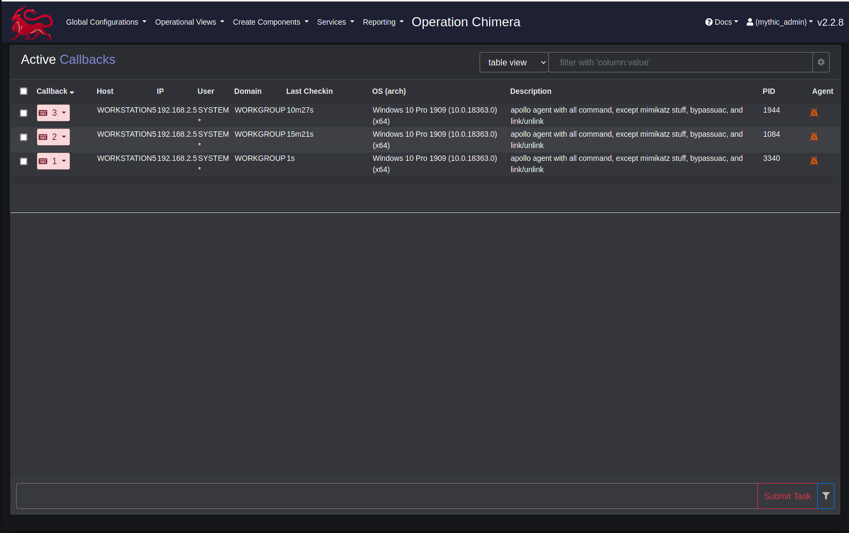
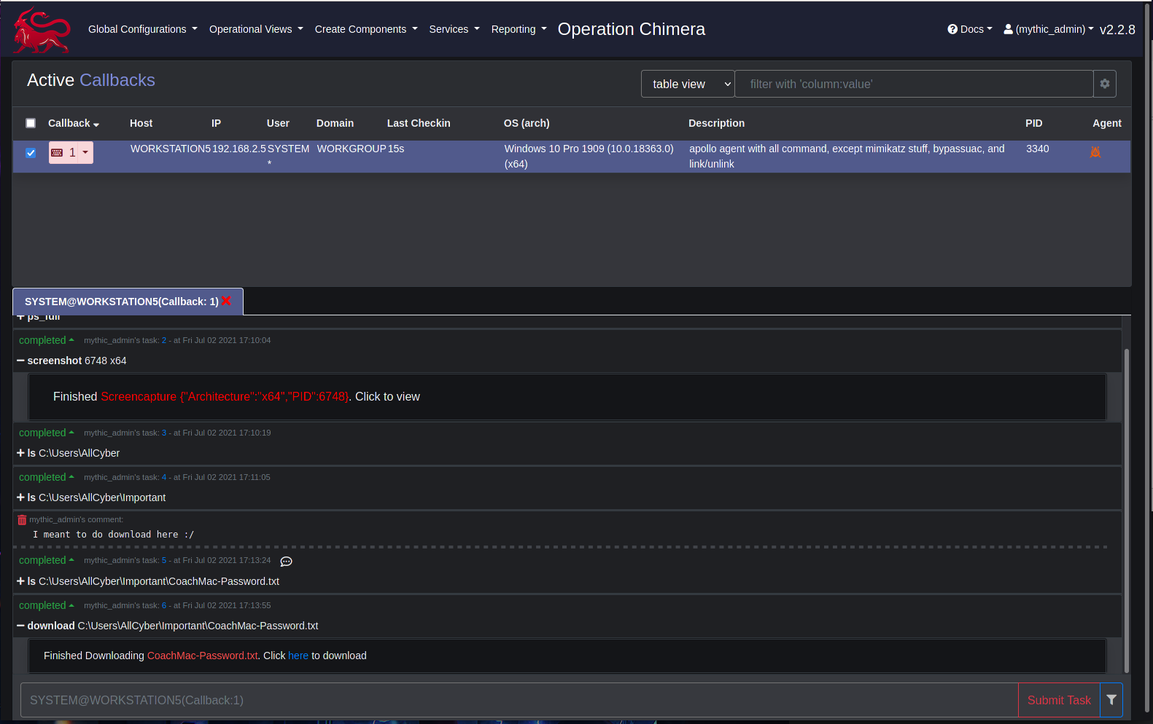
Test #3 - Postexploitation

Slide 37
Test #3 - Random Thoughts
This would require a little recon first, to find a service that runs .NET
A lot less unnecessary callbacks, so less noise 👍
The Azure Guest Agent runs as System at startup 👍
How many other places in the registry can control environment variables? 🤔
How about modifying environment variables without touching the registry? 🤔

